Slide 1

Project Review-2
(Literature Review / Applications Survey)
Front-End Development Frameworks
Project Title : Book Recommendation app with genre filters
2410030258-Alekhya Reddy
2410030266-Harshitha Reddy
2410030259-Bhavya Praneetha
Department: CSE

Slide 2
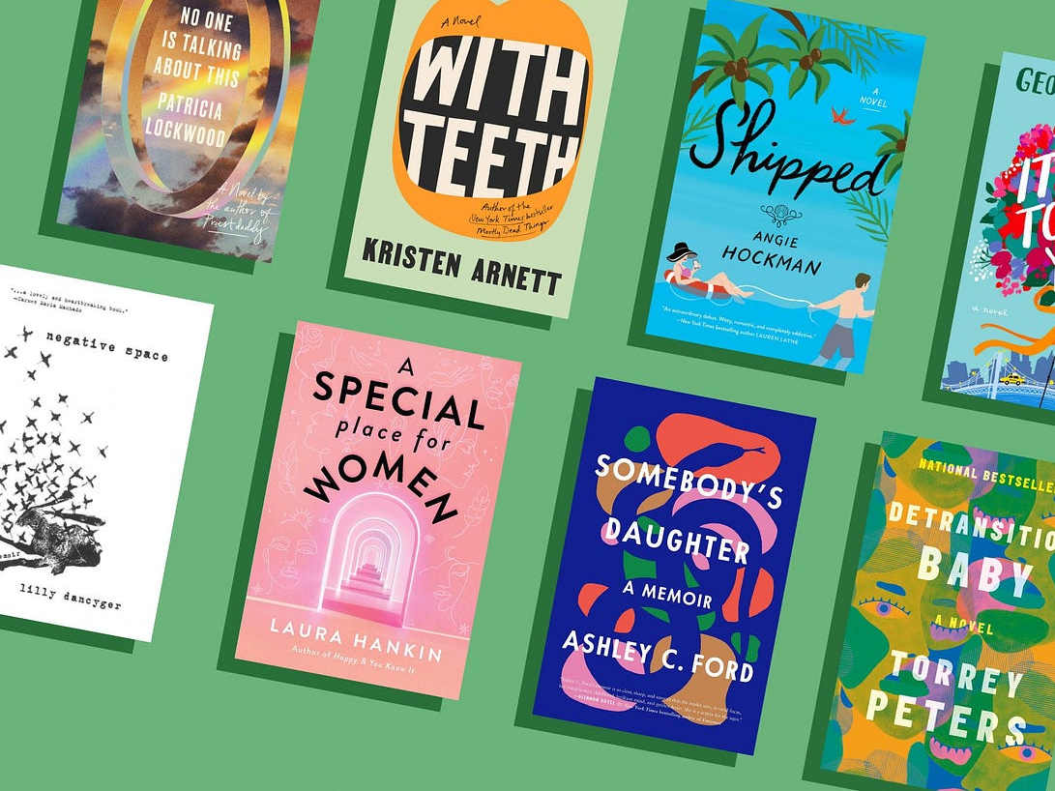
Relevance to Project Title
A front-end framework is important because it saves time, improves performance, ensures consistency, and makes apps easier to scale and maintain.
From the research we read, it’s clear that apps work better when they have quick, responsive designs and easy-to-use features. Good frameworks help make that possible. The studies also showed that when users can quickly filter and explore, they enjoy using the app more — exactly what we want for our project.

Slide 3
Depth & Quality of Literature Review
Year | Title / Authors | What It Shows | Why It Helps Our App | Link
2025 | IMAGINE: Multi-Modal Genre Identification | Uses book text + cover + metadata to detect genres, even with missing data. | Helps improve genre filters and makes recommendations more accurate. | https://arxiv.org/abs/2505.03839
2024 | LightFusionRec: Lightweight Transformers-Based Rec | Combines text and genre info in a lightweight way for fast recommendations. | Shows how to make our app quick and efficient with less lag. | https://arxiv.org/abs/2410.15656
2022 | The Unfairness of Popularity Bias in Book Recommendation | Finds that popular books are shown too much, niche books too little. | Explains why filters matter for showing diverse books, not just bestsellers. | https://arxiv.org/abs/2202.13446
2023 | Bookish reads: Content-Based Book Recommendation | A Medium project where users get recommendations based on genre + title input, focusing on genre-based discovery. | Bookish Reads is useful because it shows how to use TF-IDF to suggest books by genre and title, which is the same idea as your app | https://medium.com/@miriamudefi/building-a-book-recommendation-system-based-on-content-based-filtering-using-tf-idf-vectorizer-a13cd2a92b6d

Slide 4
Critical Analysis, Synthesis & Gap Identification
Current book recommendation systems (e.g., Goodreads, Amazon) provide personalized suggestions and allow users to explore books by popularity or ratings.
Many apps focus mainly on ratings and popularity rather than genre-based filtering for quick discovery.
Some platforms have complex UIs, which can reduce ease of use, especially for new users.
Performance issues occur in large datasets, leading to slower loading or navigation
This project aims to build a simple, user-friendly book recommendation app that emphasizes real-time genre filtering for faster book discovery.
.

Slide 5
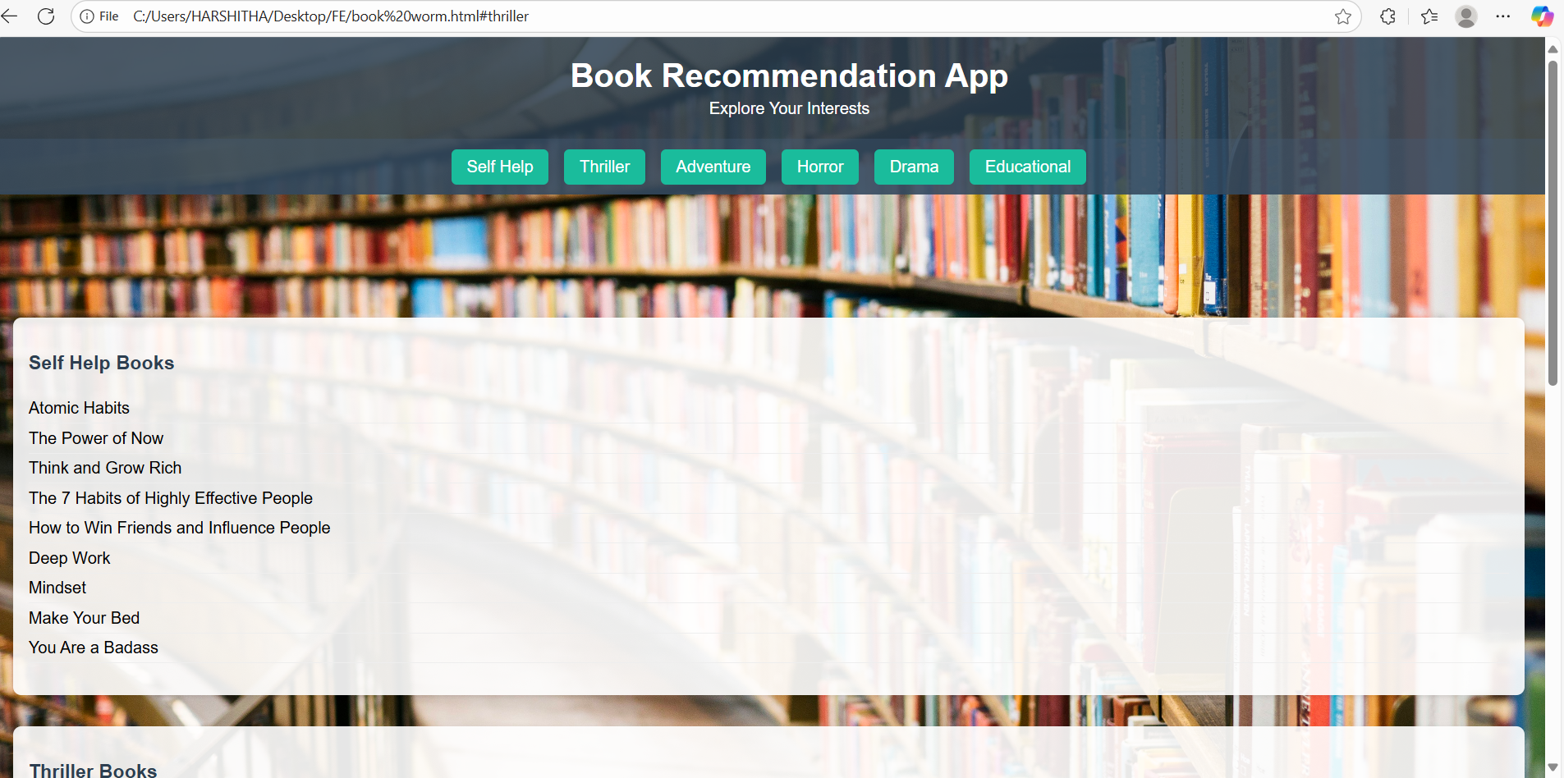
Project Implementation Started

Slide 6
THANK YOU

